Slide 1
Social and Political Effects Of Technology
Dr. Ivana Luknar, sociologist
Email: ivana.luknar@ips.ac.rs
ivanaluknar@gmail.com

Slide 2
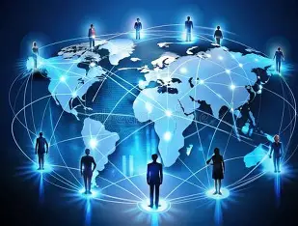
TECHNOLOGY AND SOCIETY - MULTUPLE EFFECTS

Slide 3
Turning point in the history of humanity
“We are the last.
The last generation to be unaugmented.
The last generation to be intellectually alone.
The last generation to be limited by our bodies.
We are the first.
The first generation to be augmented.
The first generation to be intellectually together.
The first generation to be limited only by our imaginations” (Kurzweil, 1999, p.3)
Source: Kurzweil, R. (1999). The Age of Spiritual Machines: When Computers Exceed Human Intelligence. Viking Press.

Slide 4
ADVANCED TECHNOLOGIES
Area | New next-generation systems
Materials & Energy | Structural Battery Composites Advanced nuclear technologies Osmotic power systems
Biotechnology & Synthetic Biology | Engineered Living Therapeutics GLP-1s for neurodegenerative disease Autonomous biochemical sensing
Digital & Computational | Agentic AI Application-specific semiconductors Advanced connectivity Quantum technologies

Slide 5
Technology – significant role in shaping society
Contemporary technologies reflect the priorities of powerful groups and thus reinforce their established authority rather than automatically promoting liberation (Feenberg 2002).
Moving toward a more democratic order cannot be achieved simply by altering ownership arrangements; it requires revising the technical routines that structure work and social life.

Slide 6
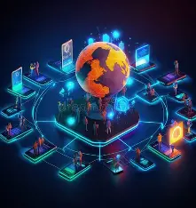
The impact of technology – three levels of analysis
MESO LEVEL (STATE)
GLOBAL
(MACRO LEVEL)
MICRO LEVEL (INDIVIDUAL)

Slide 7
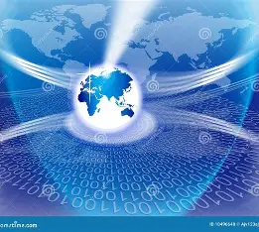
Global level of analysis
Power dynamics
Megashift
Global supply chains
Global race and tensions

Slide 8
Global level of analysis
Advancements in technology are paving the way for global polarization.
Geopolitical tensions are rising.
“The fate of humanity must never be left to the ‘black box’ of an algorithm. Humans must always retain control over decision-making functions — guided by international law, including international humanitarian and human-rights law and ethical principles. Humanity’s hand created AI. Humanity’s hand must guide it forward”.
United Nations Secretary-General António Guterres

Slide 9
State level of analysis
Advancements in technology as game-changer
Opportunities
Risks

Slide 10
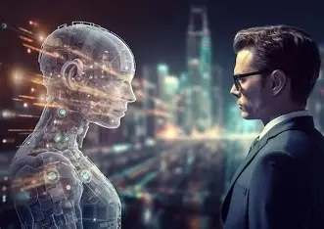
Micro level of analysis
Social identity
Social relationships
New social forms
Social being
- who we are
- who we think we are
- who we might become
- who we think we might become

Slide 11
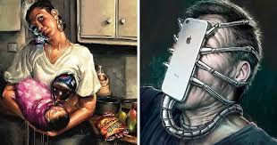
Transformation of Human
Transformation of reality
Transformation of communication
Transformation of living
Transformation of working
Social being as market entity

Slide 12
Challenges
New forms of social deviations
Alienation
Technology dependency

Slide 13
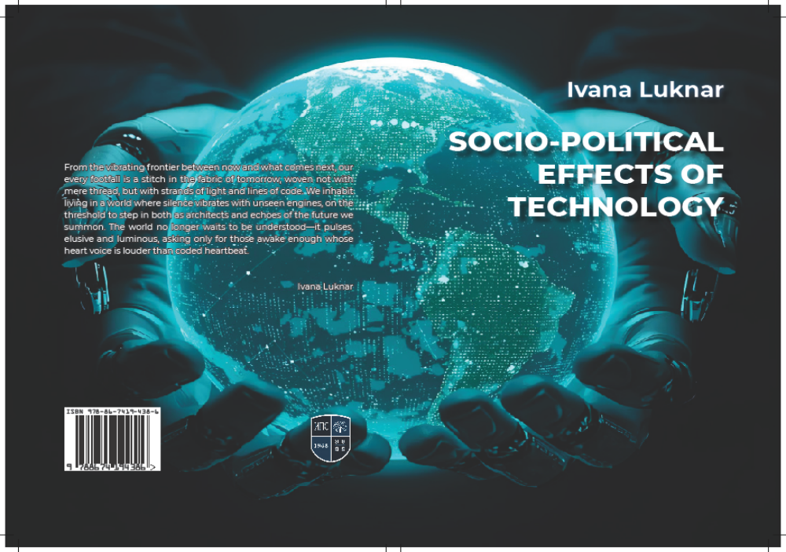

Slide 14
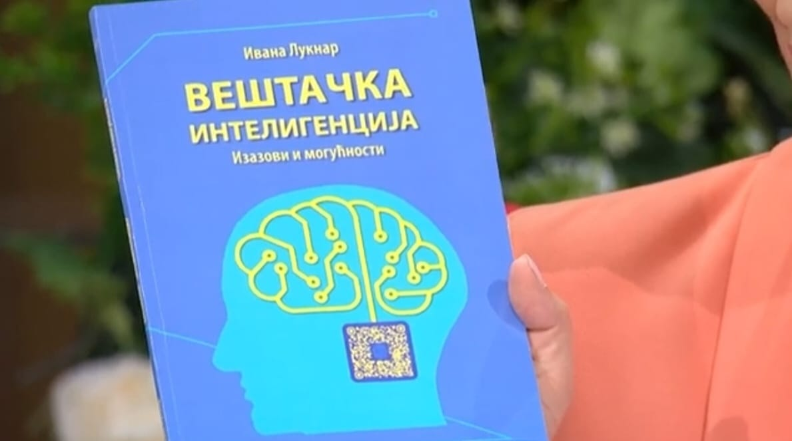

Slide 15
THANK YOU FOR ATTENTION

